Slide 1

TASK 1 PRESENTATION BY GROUP 21
CEF 440
Dr Nkemeni Valery

Slide 2
Objectives:
Completely understand the “Mobile app development process” , by studying:
The various types
Some different frameworks and programming languages
The requirement engineering process
The various architectures and design patterns as well as…
The entire development cost

Slide 3
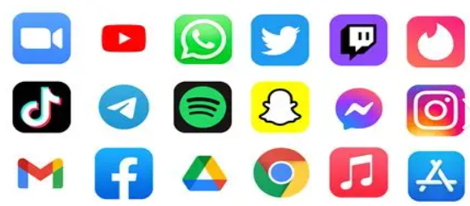
Mobile Applications
They are simply software programs designed to run on smartphones or tablets which could be either Android or iOS devices.
This programs are created to solve 1 or more of the problems faced by different individuals in the world
They are considered to be better than websites for some basic reasons:
Offline functionalities
Better performance and responsiveness
Improved security and sandboxing(apps isolated from one another through out the operating system)

Slide 4
Types of Applications
Some companies may decide to create both a mobile application and website for the following reasons:
Easy access anytime and anywhere
Better user experience
Easy discovery
Native applications
E.g. Whatsapp
Web applications
Gmail(web version)
Hybrid applications
E.g.Instagram

Slide 5
Mobile App Programming Languages
Choosing the right programming language is important because it affects the performance, scalability, and overall user experience of the application.
Android development
Ios Development
Cross-Platform Development(both Android and iOS)
JavaScript: enables developers to create mobile apps using web development skills
Dart: allows for fast and visually appealing application development
Using Java:stability, large community support, and strong performance
Using Kotlin: simpler and more concise
Swift: It is faster in performance, easier to read and write
Objective-C: is the older language

Slide 6


Mobile App Development Frameworks:
Mobile app development frameworks are important tools that help developers build applications faster and more efficiently
Flutter
Primary Language: Dart
Platforms: Android, iOS
One of its main advantages is its speed, especially with features like “hot reload,” which allows developers to see changes instantly while working on the app
React Native
Primary Language: JavaScript
Platforms: Android, iOS
One key benefit is that developers can reuse components, which helps reduce development time

Slide 7

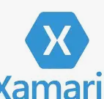
Xamarin
Primary Language: C#
Platforms: Android, iOS
It allows developers to create cross-platform apps with performance that is close to native apps
Ionic
Primary Language: HTML, CSS, JavaScript
Platforms: Android, iOS
Ionic makes it easy to create simple and functional apps quickly, although it may not perform as well as fully native apps in more complex situations.

Slide 8
Mobile App Architectures and Design Patterns:
It refers to the way developers organize code into structured components in order to make applications maintainable, scalable, testable, and easy to update.
They main types include:
MVC(Model-View-Controller): In this architecture, the Model is responsible for handling data and business logic, the View is responsible for displaying the user interface, and the Controller manages user input while updating both the Model and the View.
MVP(Model–View–Presenter): It is a UI architectural pattern that separates an application into three components to improve testability, maintainability, and separation of concerns.
MVVM(Model–View–ViewModel): It is a design pattern for structuring user-interface code that improves separation of concerns, testability, and maintainability.
Clean Architecture: Which mainly organizes code to be independent of frameworks, UI, databases, and external agencies. The goal is maintainability, testability, and the ability to change implementation details (UI, DB, external services) without changing business rules.

Slide 9
Requirement Engineering Process
Requirement Engineering is a systematic and structured process of identifying, analysing, documenting, validating, and managing the requirements of a software system to ensure that it meets stakeholder needs and operates within defined constraints.
The various Phases of requirement Engineering include:
Stakeholder identification and classification:
The objective is to identify everyone who influences or is affected by the system
Primary stakeholders: These are the end users if the product i.e. customers, students, staffs, etc.
Secondary stakeholders: These includes the admins, managers and support staffs of the system.
Tertiary Stakeholders: These are the developers, testers and regulatory bodies of the system.

Slide 10
b. Problem definition and scope framing:
We are required to answer the following questions:
What is the current problem? Who experiences it? Why does it matter?
What is included or excluded (the scope of the project)? What is the possible risk?
c. Requirement extraction phase:
The various ways used to obtain requirements from stakeholders, maybe through Surveys, brainstorming sessions, interviews, etc
d. Documentation:
Converting raw input into organized, readable format in an SRS (structured requirement specifications) documents which includes what the project is about the functional requirements and non-functional requirements
e. Requirement Validation:
Ensures stakeholders agree with the requirements. They check if the requirements are clear, testable and realistic

Slide 11
Mobile App Development Cost Estimation:
It provides a detailed estimation of the cost required to develop a mobile application, identifying key cost drivers, estimation techniques, sample calculations, hidden costs, and strategic insights.
Cost drivers
App complexity
Platform choice
Features the application may contain:
User Authentication, Payment Integration, Chat/Messaging system, etc
4. Team structure
5. Development time: Time is directly proportional to cost

Slide 12
Estimation Techniques
Expert Judgment: Usually when someone who has done it before and with a high success rate.
Analogous Estimation: Comparing it to similar already existing apps.
Bottom-Up Estimation: Breaking the project into smaller components and estimating each part independently.
Hidden Costs
This are the indirect cost experienced throughout the Lifecycle of the project
Maintenance
Server hosting
App store

Slide 13
Thank you for your keen attention…

